Slide 1

Kehi no Matsubara sea trash group 〈sea trash survey team〉
Kubota Manato Ishibashi Yushin Kato Risa
Notes:
This is the sea trash survey team of the Kehi no Matsubara sea trash group .（ス）

Slide 2
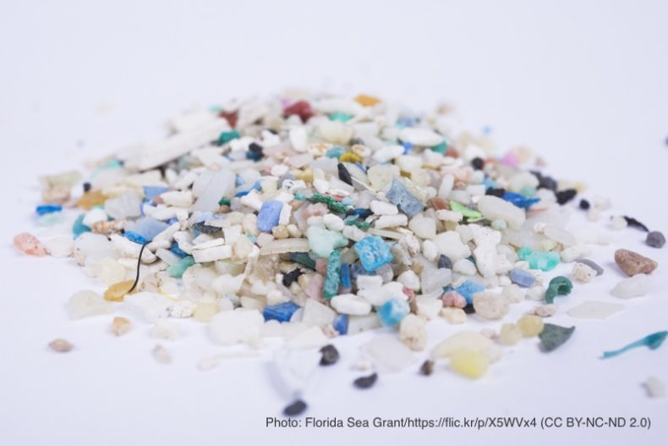

動機
After learning about the seriousness of the microplastic problem, we decided to find out how serious it is in the area where we live.
Notes:
We learned about the seriousness of the microplastic problem, and we decided to find out how serious it is in our area. Look at this picture, these are microplastics. We did this last year and also considered it. However, when I looked back at it , I found some of the conclusions to be troubling, so I decided to investigate whether it was really true. We believe that this result can have a significant effect on reducing microplastics and plastic waste. Also, our survey can help you make it realize SDGs goal 14. “Life below water.”（ス）

Slide 3
預想
Effect of changing the amount of microplastics
・sea waves, wind
１ The closer the distance from the sea, the
greater the amount of microplastics.
２ The fewer visitors, the grater the amount of
microplastics.
Notes:
We thought, ``Microplastics may be influenced by waves and wind rather than by visitors to the coast,’’ so we expected in these ways. (ス)

Slide 4
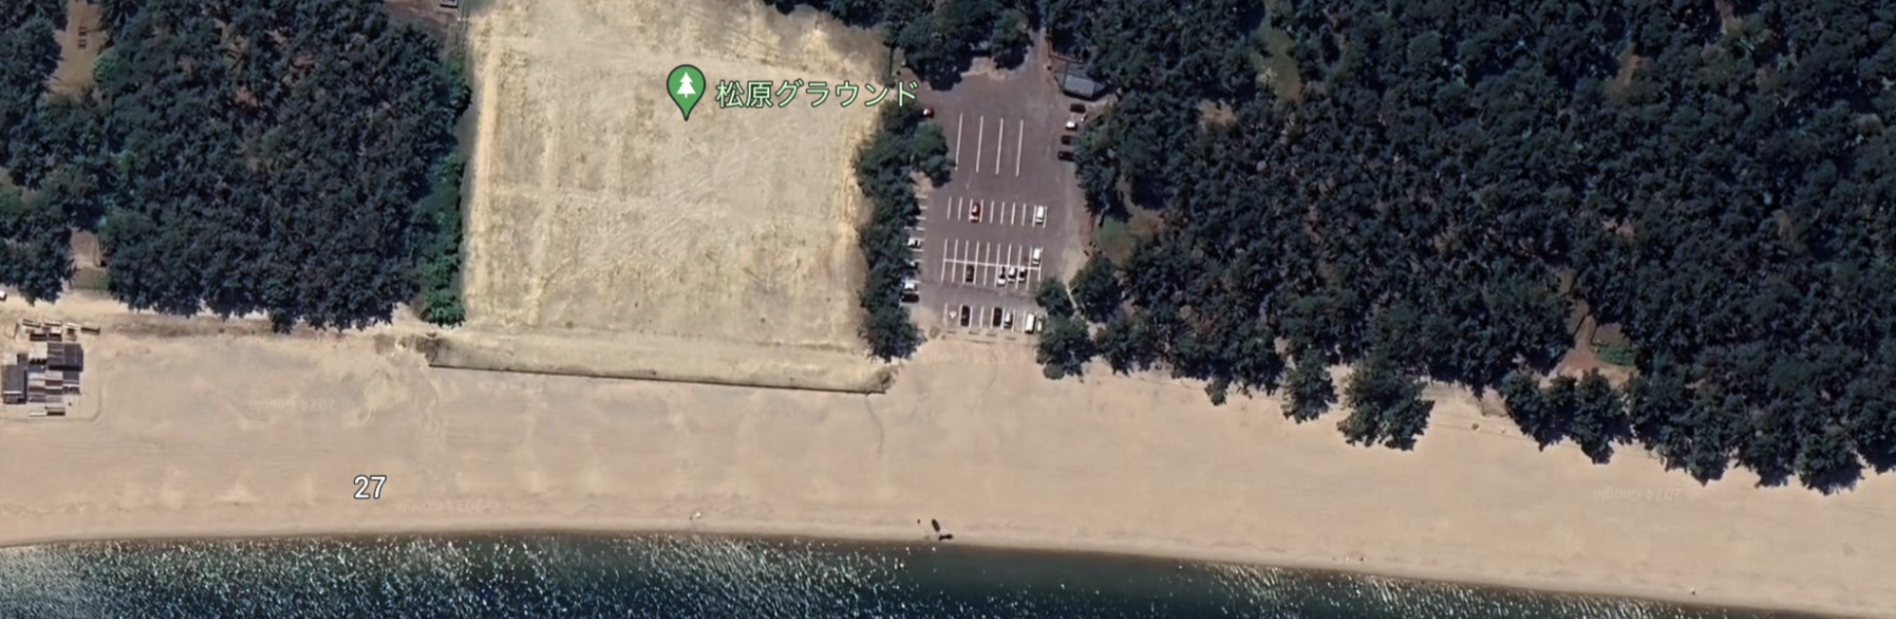
調査方法
①Set the coast into 18 locations and collect sand
６
５
４
３
２
１
Notes:
This is a research method. Sand will be sampled from a total of 18 locations, with the city’s Kehi no Matsubara coastline divided into 6 locations, and further divided into 3 locations based on distance from the sea. （ス）

Slide 5
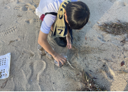
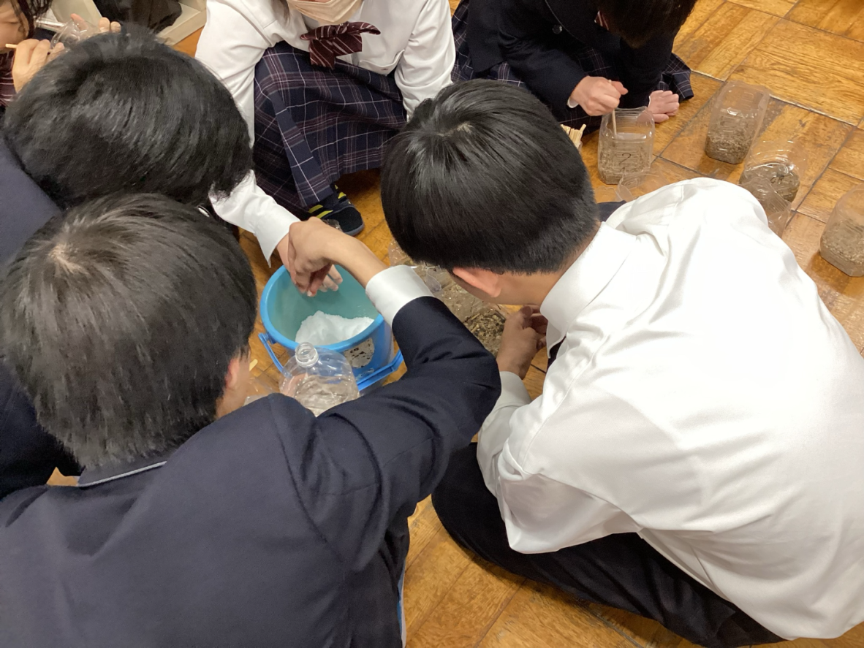
②Pour saturated salt solution into the sand
and find out how many microplastics there are
①collecting sand
②find out microplastics
Notes:
Then, a saturated saline solution is poured into the collected sand to determine how many microplastics are there. This is a photo of the actual investigation. （ス）

Slide 6
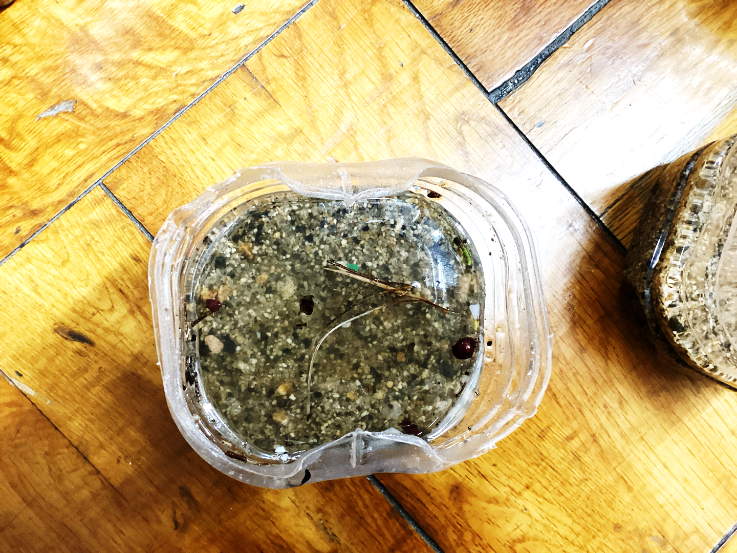
11/25 Result at a certain point
Notes:
Floating objects can be seen like this. This is a result from a certain point on November 25th, （ス）

Slide 7
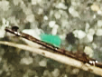
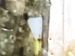
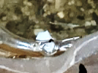
Enlarged view
Notes:
microplastics are often brightly colored and are relatively easy to discover. （ス）

Slide 8
每個調査時期的推移
Notes:
We conducted four surveys and found that there were more microplastics in autumn. （ス）

Slide 9
Precipitation ・ Wind speed
 | Average precipitation (mm) | Average wind speed (m/s) | Microplastics(pieces)
①(6/2～6/20) | 0.92 | 4.02 | ３
②(6/21～7/29) | 11.82 | 3.58 | ４
③(8/17～10/20) | 6.80 | 3.77 | ４
④(8/17～11/24) | 5.95 | 4.15 | ９
Notes:
Additionally, the amount of precipitation and wind speed were higher in autumn than in other seasons.（ス）

Slide 10
Rains a lot
Lots of microplastics
Strong wind
Notes:
This led us to believe that rain, wind and waves caused by wind may have an effect on the amount of microplastics. （ス）

Slide 11
結論
Rain and wind are the tow causes of changes in the amount of microplastics.
(especially the wind)
The waves generated by these are also an important factor.
Notes:
This conclusion raises concerns that waves will carry trash from allover the world to the coast, and that rough weather will make the coast rougher. These are natural phenomena that cannot be approached with modern technology, but we can also reduce plastic waste.
（ス）

Slide 12

Let’s protect our planet from microplastics!
Notes:
To reduce microplastic in our oceans, let’s try to reduce the plastic in our daily lives first! Let’s protect our planet from microplastics!（ス）

Slide 13
参考文献
・ethicame「マイクロプラスチックとは？発生原因や影響、対策まで」https://ethicame.com/shop/information/microplastics?srsltid=AfmBOorA8lS1ZdIF3XedcrZ88_dB2s87kUlxa_QuIcRNXv6qBAS2jPy0
・気象庁「波浪に関するデータ」https://www.data.jma.go.jp/gmd/kaiyou/shindan/index_wave.html
・気象庁「過去の気象データ」https://www.data.jma.go.jp/obd/stats/etrn/index.php?year=2025
・プラなし生活「海洋マイクロプラスチックとは？その発生源は？」https://lessplasticlife.com/marineplastic/source/microplastics_sources/
・特定非営利活動法人THAP(タップ) facebook上の2024年6/2の投稿https://www.facebook.com/story.php/?story_fbid=850024510502494&id=100064848572080&_rdr
・連合福井「敦美地区「気比の松原海水浴場」での清掃活動を実施！」https://rengo-fukui.main.jp/f_blog/%E6%95%A6%E7%BE%8E%E5%9C%B0%E5%8C%BA%E3%80%8C%E6%B0%97%E6%AF%94%E3%81%AE%E6%9D%BE%E5%8E%9F%E6%B5%B7%E6%B0%B4%E6%B5%B4%E5%A0%B4%E3%80%8D%E3%81%A7%E3%81%AE%E6%B8%85%E6%8E%83%E6%B4%BB%E5%8B%95%E3%82%92/
・福井新聞Ｄ刊「松原小と松陵中、「気比の松原」ともに守る 環境学習で毎年清掃 まちぶら」https://www.fukuishimbun.co.jp/articles/-/2140170
Notes:
This is a reference. （ス）

Slide 14
Thank you for your attention
Notes:
That’s all. Thank you for your attention.

